Slide 1
Innovative test solution
Provider
- Probe pin Datasheet -

Slide 2
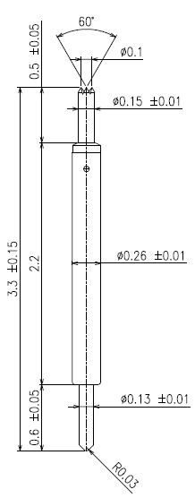
※ POGO type – 0.35 pitch
IVB-SAR-330-026-A088-00
Pitch | 0.35mm
Total Length | 3.3mm
Use Length | 2.9mm
Use Stroke | 0.4mm
Recommended Top Plunger Stroke | 0.15mm
Recommended Bottom Plunger Stroke (Pre-load) | 0.25mm
Max Stroke | 0.5mm
Spring Force at Use Stroke | 22gf at 0.4mm Stroke
Operating Temperature | -40 to 150°C
DC Resistance | Avg. 68.50mΩ at 0.4mm stroke
Current Rating | 1.0A
Self Inductance @10GHz | 0.962 nH
Capacitance @10GHz | 0.197 pF
Top Plunger | BeCu / Au over Ni
Bottom Plunger | BeCu / Au over Ni
Barrel | Phosphor bronze / Au over Ni
Spring | Music Wire / Au over Ni
Insertion Life | 100,000 cycles at 0.4mm Stroke

Slide 3
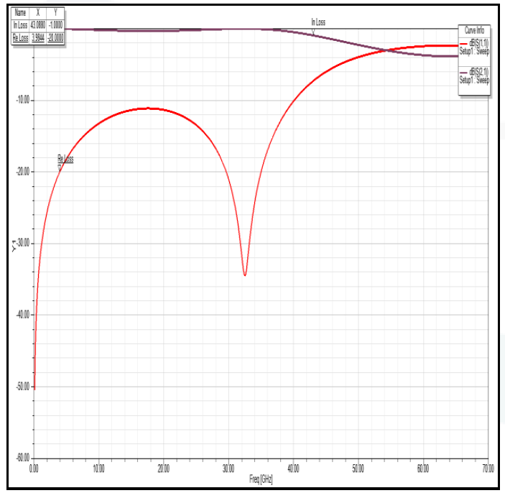
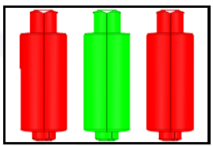
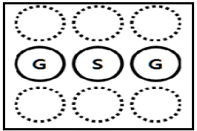
※ POGO type – 0.35 pitch

Slide 4
Thank you.

